Slide 1
Master Mind
Yuxin Lei
Jintao Sun
07/07/2020

Slide 2
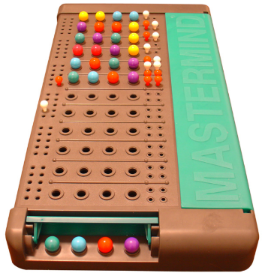
Introduction
Game of Master Mind
- One player (computer) has four slots, and each slot will contain a ball that is red (R). yellow (Y). green (G) or blue (B). The other player (the user) are trying to guess the color of balls in the slots. When you guess the correct color for the correct slot, you get a "hit:’ ; If you guess a color that exists but is in the wrong slot, you get a "pseudo-hit:’
- Can have more colors
Time complexity is O(n)

Slide 3
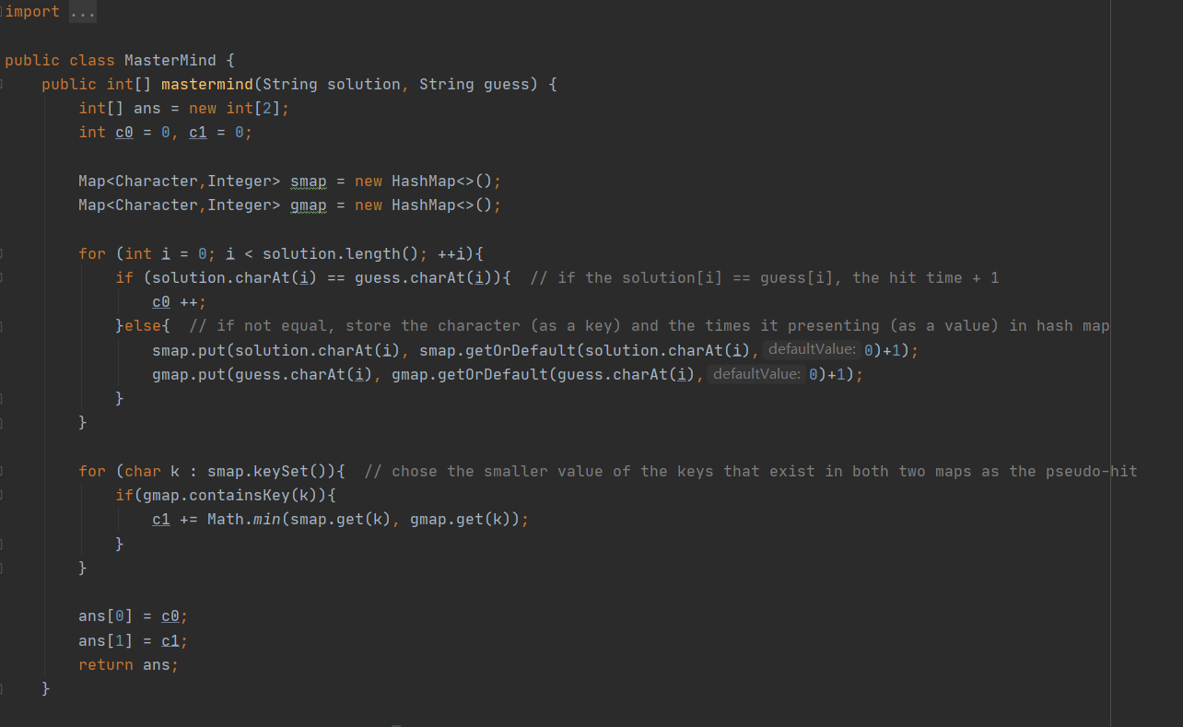
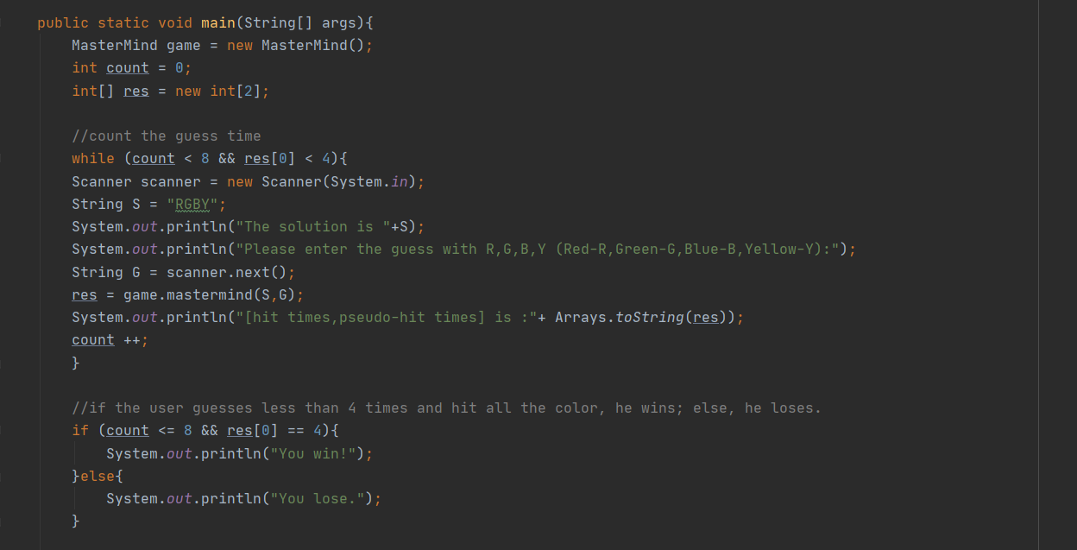
Solution (code)

Slide 4
Solution
Using hash map to store the solution array, guess array and the hit times.
Assume solution is RGBY and guess is BBRG, how to get the pseudo-hit?
Solution map
Key | R | G | B | Y
Value | 1 | 1 | 1 | 1
Guess map
Key | B | B | R | G
Value | 1 | 2 | 1 | 1
If both two maps contains a specific key, chose the smaller value as the pseudo-hit of this key.
The [hit, pseudo-hit] array is [0,3] in this example.

Slide 5
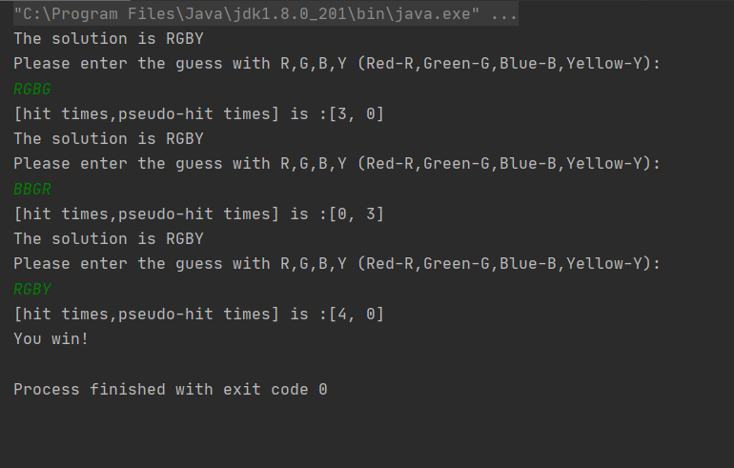
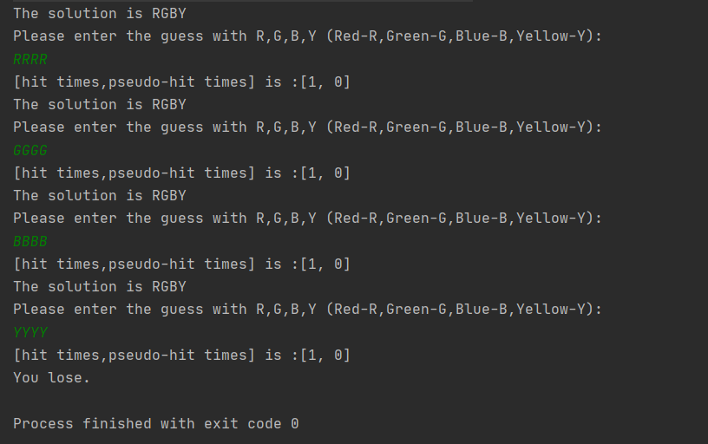
Empirical Result
You win!
You lose.

Slide 6
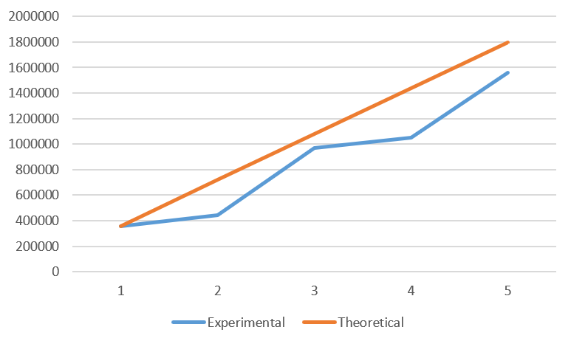
Graph of Running Time

Slide 7
Conclusion
Key point is how to find the pseudo-hit times.
- What is the key and value of hash maps?
- How to update the appearance times of a key?
The deviation between experimental and theoretical values might caused by the too small testing values, or extra operations like calling the map.

